Slide 1

Excel From Scratch: Your Beginner's Guide
Welcome to the world of spreadsheets! This guide unlocks Excel's power step-by-step.
We'll explore the interface, formulas, formatting, and managing workbooks efficiently.

Slide 2

Touring the Excel Interface
The Ribbon
Central command center with File, Home, Insert tabs for easy navigation.
Quick Access Toolbar
Customize shortcuts for your frequently used commands and save time.
Formula Bar
View and edit formulas in your active cell with precision.
Cells, Rows & Columns
The structural foundation for entering and organizing your data.

Slide 3
Entering Data & Saving Your Workbook
Data Entry
Saving Workbooks
Type text, numbers, and dates directly into cells with ease.
Save files as .xlsx for modern features, or .xls for compatibility.
Use AutoFill to quickly continue data patterns.
AutoRecover protects your work against unexpected shutdowns.

Slide 4

Applying Formulas: The Heart of Excel
1
Basic Operators
2
Cell References
Add, subtract, multiply, divide, and exponentiate with +, -, *, /, and ^.
Use relative and absolute references to build dynamic formulas.
3
SUM Function
4
Formula Auditing
Calculate totals efficiently using =SUM(range).
Trace precedents and dependents to debug complex calculations.

Slide 5





Changing a Worksheet's Structure
Insert/Delete Rows & Columns
Adjust Size
Hide/Unhide
Manually or auto-adjust row height and column width for clarity.
Temporarily remove or restore rows and columns from view.
Easily modify your sheet layout as data changes.
Freeze Panes
Keep key rows or columns visible while scrolling.

Slide 6
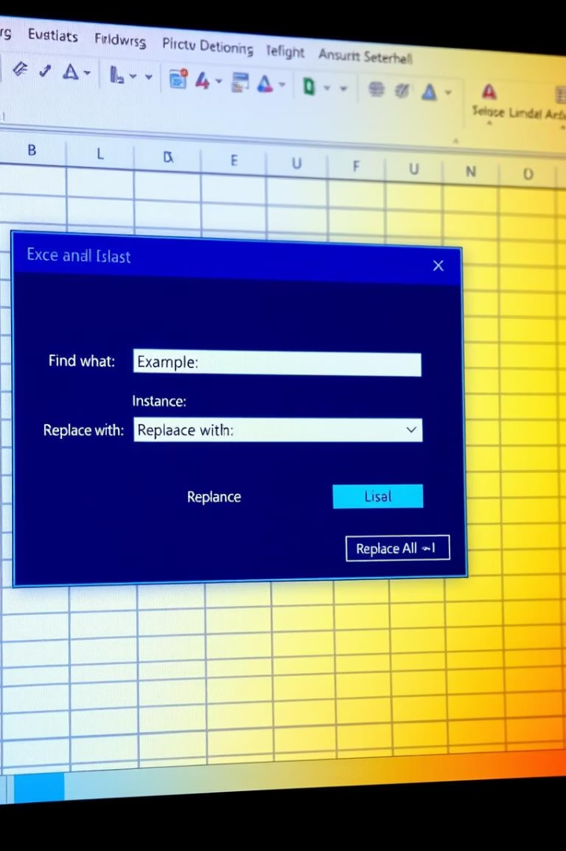




Find, Replace & Spell Check
Find Data
Locate specific entries quickly using Ctrl+F.
Replace Data
Update values safely with Ctrl+H for efficiency.
Spell Check
Use F7 to correct typos and maintain professionalism.
Wildcards
Boost searches with * and ? for partial matches.

Slide 7
Applying Fonts, Background Colors, and Borders
Fonts
Background Colors
Borders
Format Painter
Change styles, sizes, and colors to highlight text.
Use fill colors to emphasize important data points.
Add structure to tables and organize content visually.
Copy formatting efficiently for consistent design.

Slide 8
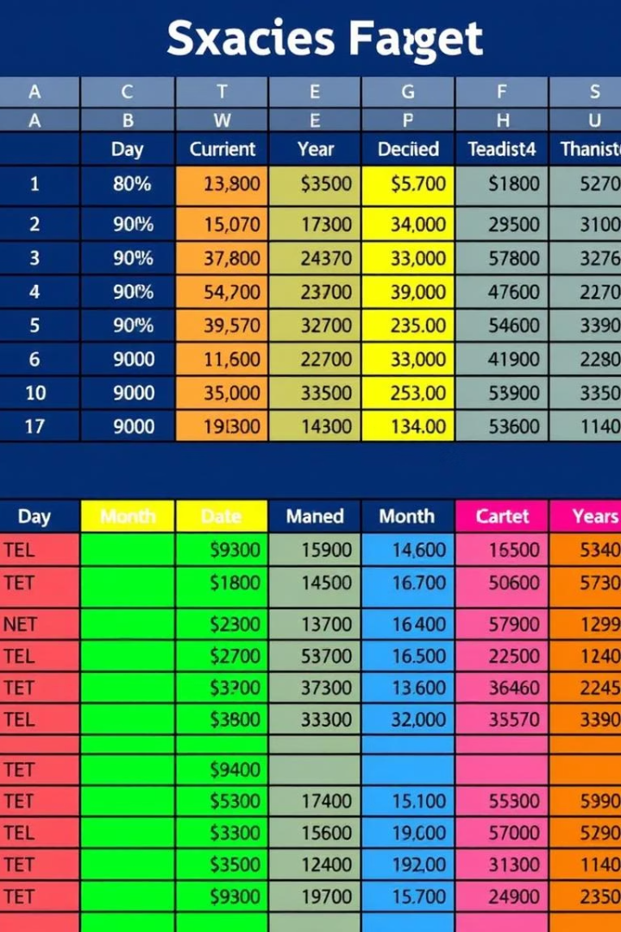
Formatting Numbers and Dates
Number Formats
Date Formats
General
Short Date
Currency & Accounting
Long Date
Percentage
Custom Formats
Decimal Places
Adjust precision to display exact values clearly.

Slide 9








Inserting Headers & Footers and Repeating Rows
Headers & Footers
Repeating Rows
Add page numbers, dates, and titles to printouts.
Keep important row labels visible on every printed page.
Scaling Options
Print Area & Margins
Fit spreadsheets to page size for neat printing.
Focus printouts on key data and adjust page layout.

Slide 10
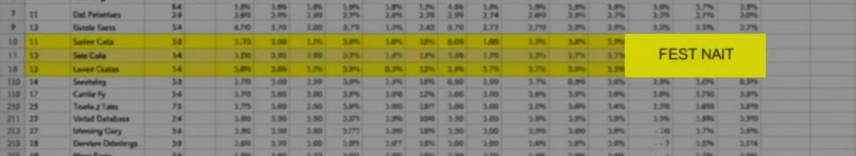
Managing Large Workbooks
Comments
Sorting Data
Add notes and context for effective collaboration.
Filtering Data
Arrange values ascending, descending, or custom order.
Grouping & Ungrouping
Find relevant info instantly using filters.
Organize data sections for concise insights.
Congratulations! You've mastered Excel from scratch and are ready to excel.

